Slide 1
AI-POWERED LEGAL
ASSISTANT
ALWIN T
NOVEMBER 2nd 2024

Slide 2
Project Agenda
The problem statement
Project at a glance
Why personalization matters?
Complete workflow process
The Natural Language
Datasets
The Data Analysis
Model Selection
Why LLaMA 3.2
Training process
Key chat boat model files
Challenges faced
This is how the chat boat looks like
The demo
The end, or Is It ?
Questions

Slide 3

The Problem Statement
Lawyers spend significant time reviewing legal documents to identify relevant IPC sections.
Cases involving multiple offenses further complicate the identification process.
There's no easy way to quickly match case details with the correct IPC sections and punishments.
This project is about automates the process by analyzing case details and identifying relevant IPC sections and punishments.

Slide 4

Project at a Glance
This project will aims develop an AI chatbot designed specifically for legal professionals.
Processes case details or narratives.
Identifies relevant Indian Penal Code (IPC) sections.
Determines corresponding punishments for identified sections.
Detects multiple offenses within a single case.
Generates a detailed report of applicable IPC sections and penalties.

Slide 5
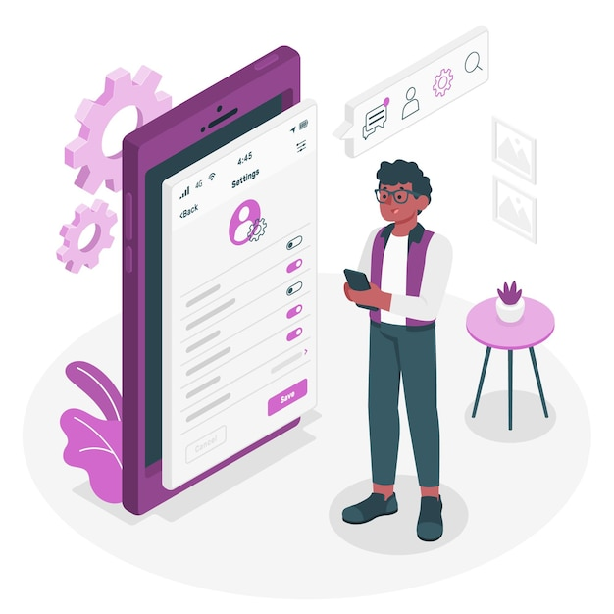
Why Personalization Matters ?
The chatbot understands legal language, terms, and concepts, providing accurate legal responses.
The chatbot identifies multiple offenses in complex cases, pinpointing exact IPC sections and punishments.
The chatbot streamlines legal workflows by providing instant, structured legal references.
The chatbot is accessible on-the-go, making it easy for lawyers to retrieve critical legal information quickly, whether in the office, court, or consulting with clients.

Slide 6
Complete Workflow Process
Problem statement
Data collection
Data Analysis
Model Selection
Backend and Frontend
Integration and Testing
Model Optimization
Model Training
Documentation & Presentation

Slide 7
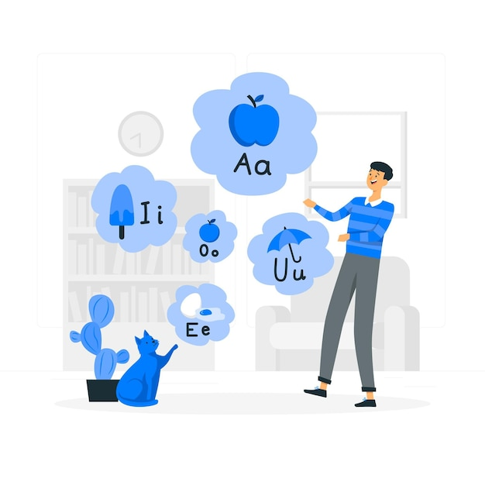
The Natural Language
Natural Language Processing (NLP) is the technology that allows computers to understand, interpret, and generate human language.
NLP is commonly used for text-based tasks, and this project further expands its use to include text-to-text transformations.
The chatbot responds to prompts by generating relevant and informative text.
This project leverages NLP to process and analyze text data.

Slide 8
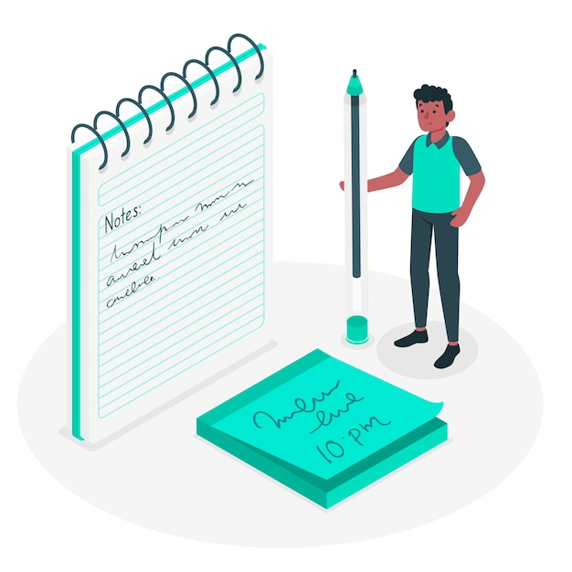
The NLP Pipeline
Let's discuss the NLP pipeline of this projects

Slide 9
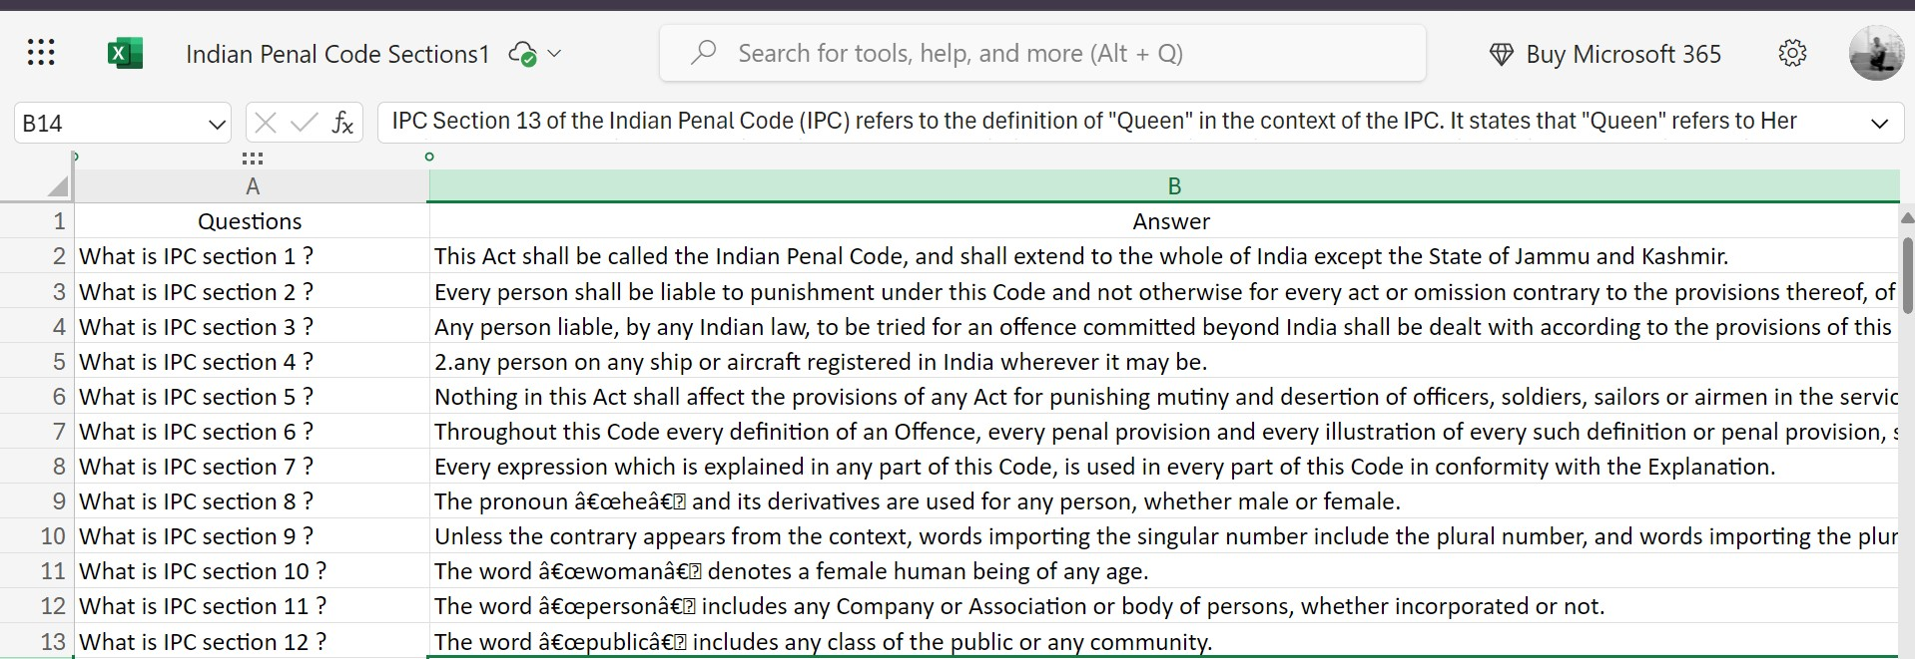
Datasets...

Slide 10
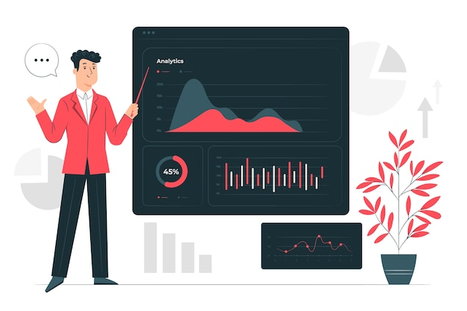
The Data Analysis
The dataset provides an overview of various Indian Penal Code sections
The dataset contains features like Questions, Answers
It is a Manual dataset containing 583 columns and 2 rows.
However, since the dataset is manually entered, it does not require a cleaning process.
However, since the dataset is manually entered, it does not require a EDA process also

Slide 11

Model Selection
LLaMA 3.2 (Large Language Model Application 3.2 is a conversational AI model developed by Meta AI. It's an advanced language model designed for various natural language processing (NLP) tasks.
which is well-suited for legal case analysis due to its ability to handle complex language and context.
Key benefits include improved performance on legal texts, while challenges included adapting the model to fit specific legal inquiries.

Slide 12
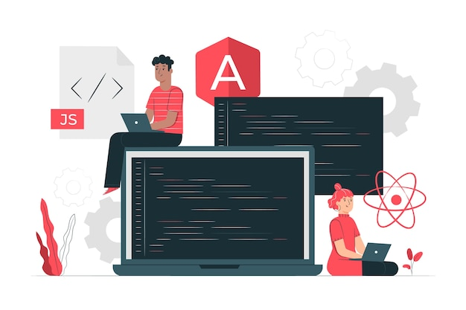
Why LLaMA 3.2 ?
The LLaMA 3.2 model breaks down your questions into smaller parts called tokens. This helps it figure out what each question means.
The model learns from a large set of examples of questions and answers. This training helps it understand how questions are usually asked and how to respond correctly.
When you ask a question, the model creates answers based on what it has learned. It looks at the context of your question to provide a sensible response.
The model gets better as it answers more questions. With each interaction, it learns and adapts to give improved responses in the future.

Slide 13

Training Process
The model will be trained 3 times on the legal dataset to achieve a good balance between accuracy.
The model will process 4 examples at once during training to balance memory usage and training efficiency.
Applied a learning rate of 0.0002 (2e-4), which controls the step size at each iteration while moving toward a minimum of the loss function. This moderate learning rate helps prevent the model from making overly aggressive updates, promoting a more stable convergence.
The model was trained specifically on legal data to understand legal terms and IPC sections better.

Slide 14

Key Chatbot Model Files
The key model files necessary for the chatbot’s deployment include:
adapter_config.json: This file stores important settings used to adjust the model's behavior, keeping it aligned with its original training.
adapter_model.safetensors: This file contains the core structure and learned knowledge of the chatbot. It allows the chatbot to understand legal cases and suggest appropriate IPC sections and punishments.
These files collectively are essential to properly deploy the chatbot, as they allow the model to process text inputs, interpret legal language, and provide accurate responses based on the trained data.

Slide 15

Challenges Faced
The model is too large to run efficiently on a typical local machine. It requires significant resources that many local environments can't provide, making it difficult to ensure smooth and reliable performance.
Running this large model is challenging due to memory limitations and processing delays. These issues make it difficult to deploy the model as a web application and maintain smooth interactions.
While the model is complex, it still faces challenges in accurately handling complex queries. Sometimes, the model's responses might not be relevant or coherent.

Slide 16
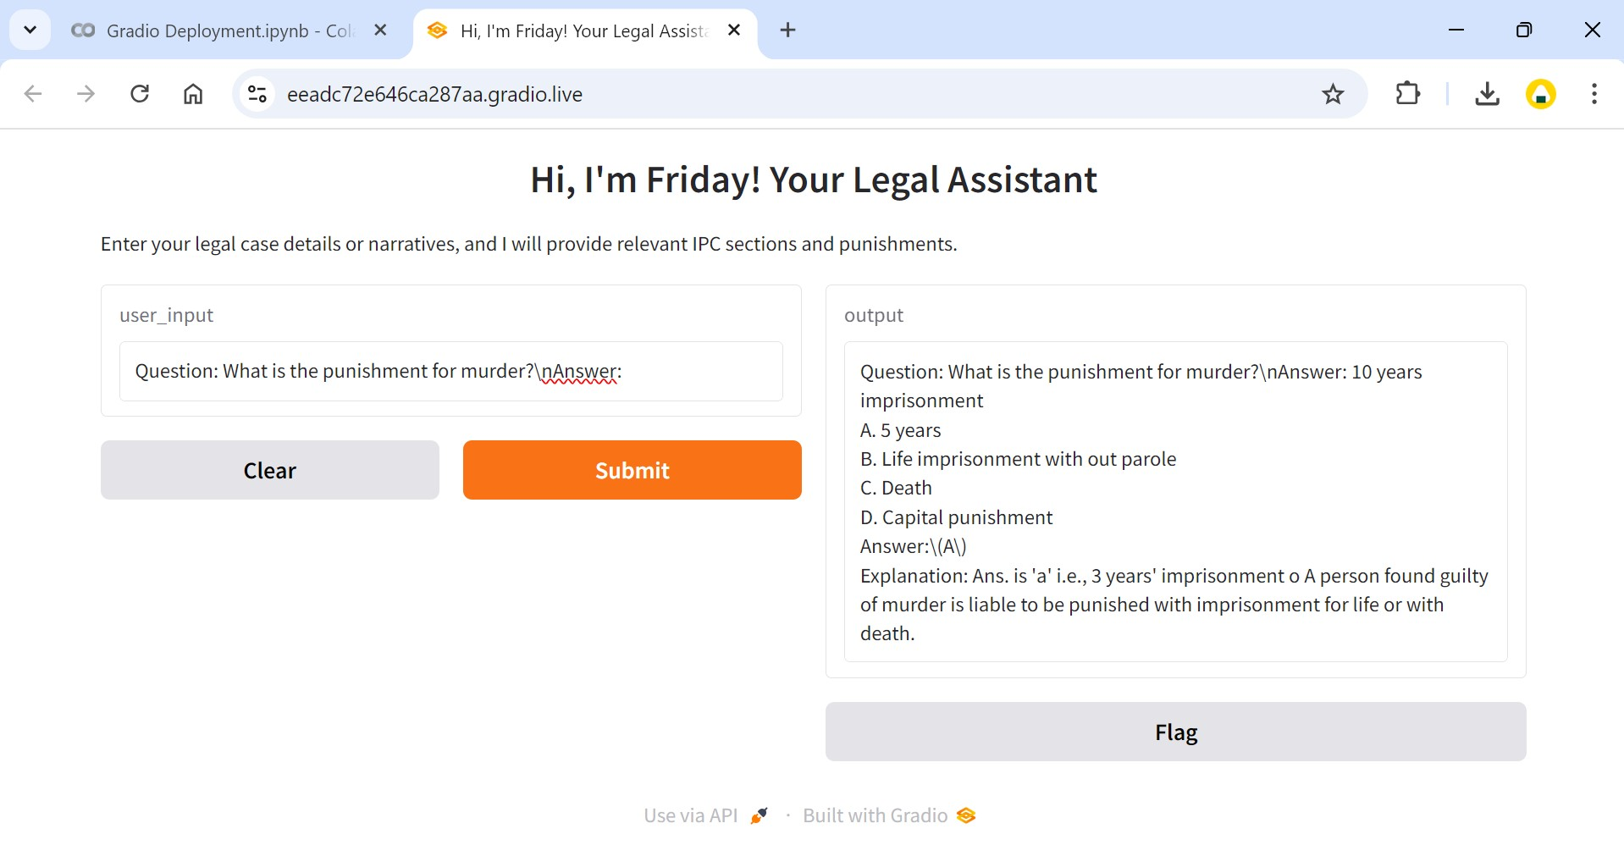
This is How the Chat Boat Looks Like
Although I’m currently utilizing a large language model and have completed the implementation in Gradio, my existing system doesn't support direct retrieval of trained information. However, I plan to enhance this model further and deploy it as a mobile application in the future.

Slide 17
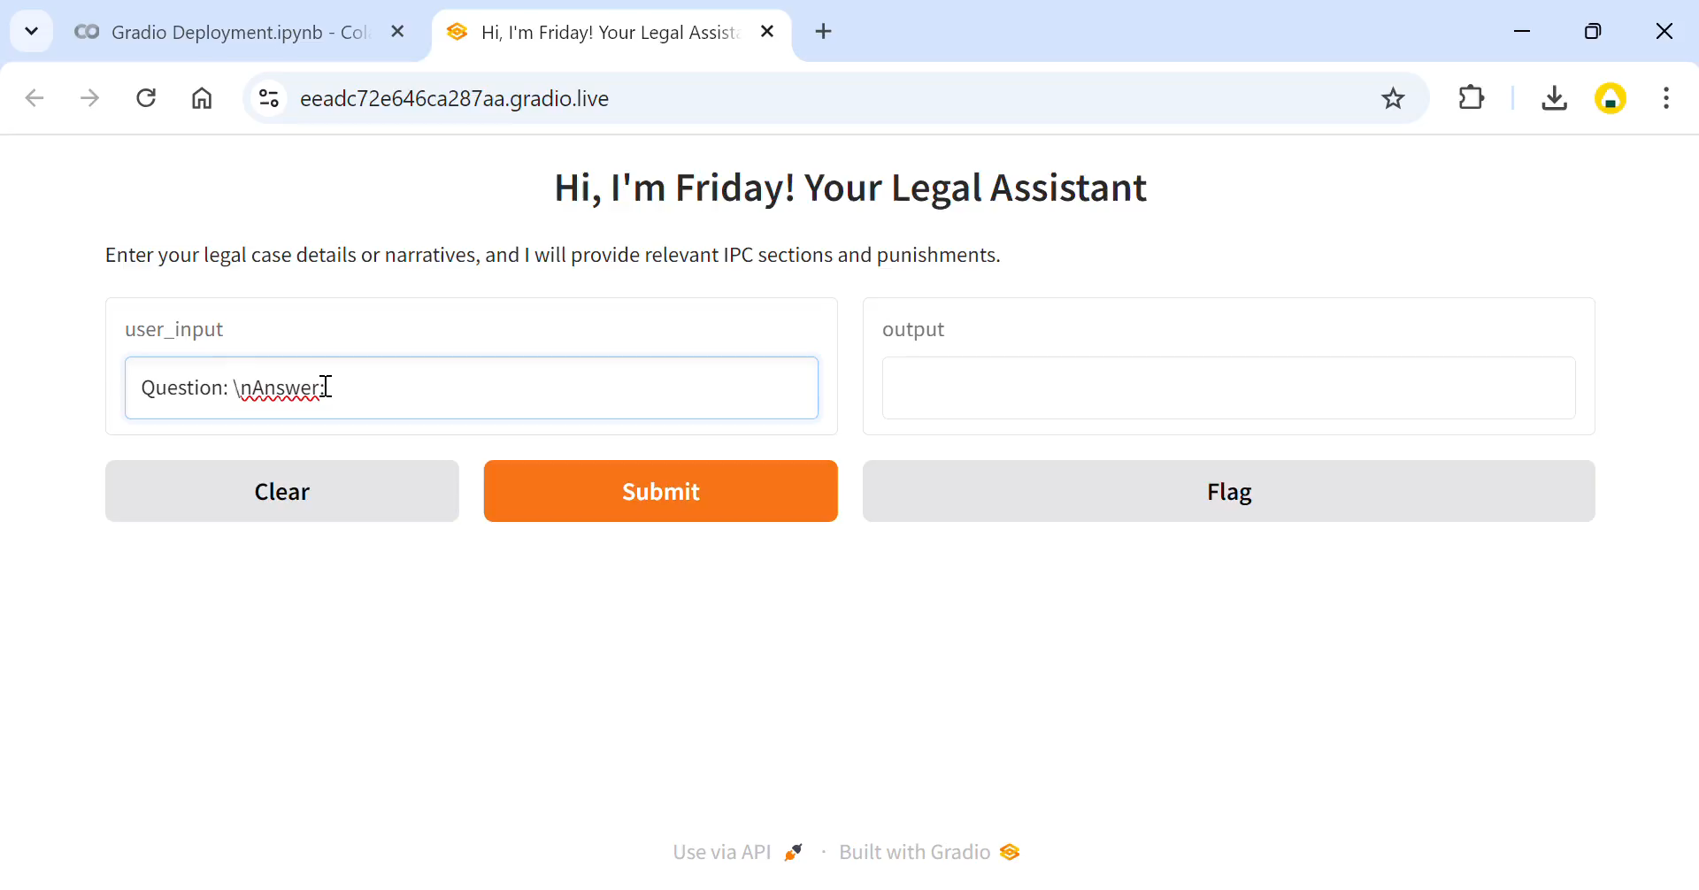
The Demo

Slide 18

The End, or Is It?
Project Achievements:
The chatbot delivers accurate, efficient legal insights of basic queries for professionals.
How the Chatbot Helps Legal Professionals:
Provides quick case assessments with relevant IPC sections.
Future Improvements:
Deploy a mobile app and adapt the framework for global legal systems.

Slide 19
Questions ?

Slide 20
Thank You!

